Slide 1

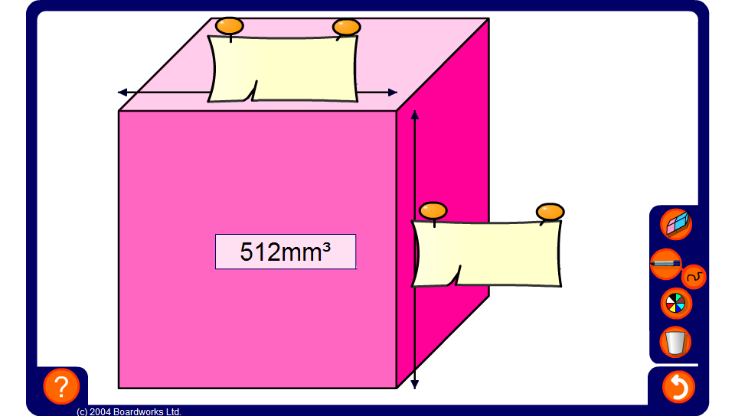


Cubes and cube roots
Notes:
Ask pupils to suggest how we can work out the length of one edge of the cube before revealing the solution.
Establish that the sides are of equal length and so we are looking for a number that when cubed gives that volume.
Allow pupils to use a calculator if needed.

